Slide 1

Statistics (AKA: Sadistics) Made Easy
by
Donna L. Agan, EdD

Slide 2

Show of Hands
Who is doing a study that involves statistical analysis of data?
What type of (quantitative) data are you collecting?
Will there be enough data to achieve statistical significance? (adequate power vs. pilot) If pilot:
  Descriptive statistics
  Chart/graph

Slide 3



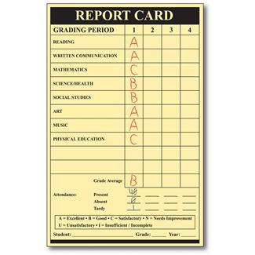



Types of data
Continuous
  Equal increments
Ordinal/Rank
  In order but not equal (Likert)
Categorical
  Names

Slide 4

What type of statistical test do I want to do?

Slide 5
Continuous Data
If comparing 2 groups (treatment/control)
  t-test
If comparing > 2 groups
  ANOVA (F-test)
If measuring association between 2 variables
  Pearson r correlation
If trying to predict an outcome (crystal ball)
  Regression or multiple regression

Slide 6
Ordinal Data
Beyond the capability of Excel – just FYI
If comparing 2 groups
  Mann Whitney U (treatment vs. control)
  Wilcoxon (matched pre vs. post)
If comparing > 2 groups
  Kruskal-Wallis (median test)
If measuring association between 2 variables
  Spearman rho (ρ)
Likert-type scales are ordinal data

Slide 7
Categorical Data
Called a test of frequency – how often something is observed (AKA: Goodness of Fit Test, Test of Homogeneity)
Chi-Square (χ²)
Examples of burning research questions:
  Do negative ads change how people vote?
  Is there a relationship between marital status and health insurance coverage?
  Do blonds have more fun?

Slide 8

Words we use to describe statistics

Slide 9

Mean (μ)
The arithmetic average (add all of the scores together, then divide by the number of scores)
μ = ∑x / n

Slide 10

Median
The middle number (just like the median strip that divides a highway down the middle; 50/50)
Used when data is not normally distributed
Often hear about the median price of housing

Slide 11

Mode
The most frequently occurring number (score, measurement, value, cost)
On a frequency distribution, it’s the highest point (like the á la mode on pie)

Slide 12
Area Under the Curve
That’s where the population lives

Slide 13
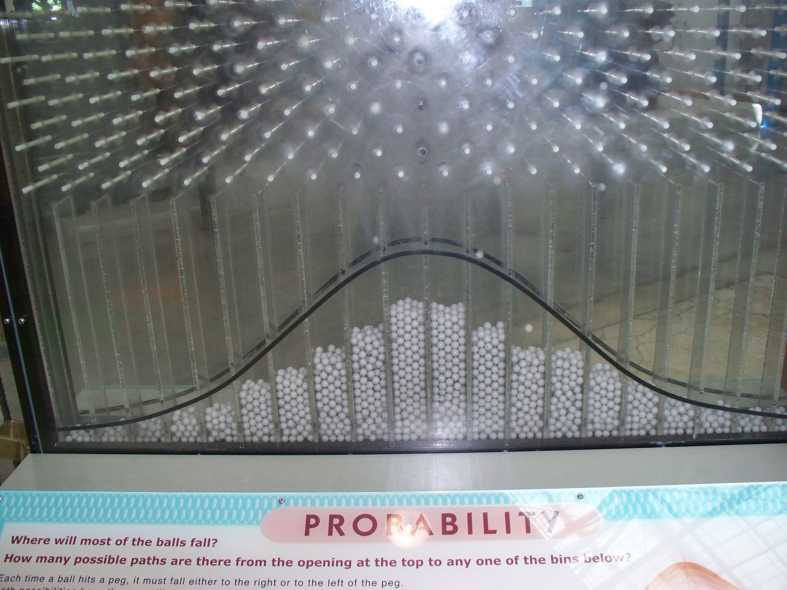
Photo courtesy of Judy Davidson, DNP, RN

Slide 14
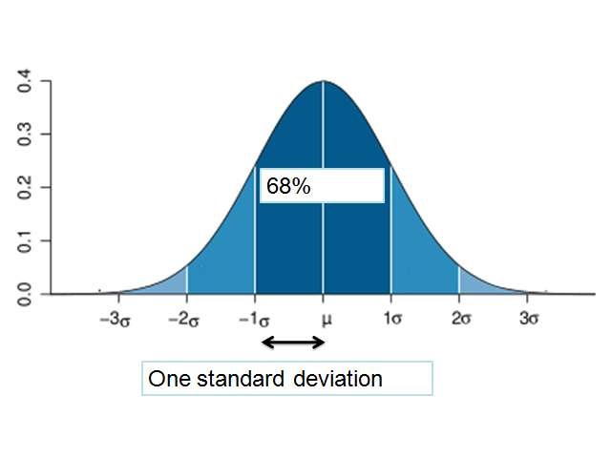
Standard Deviation (σ)
99%
95%

Slide 15
We Make Mistakes!
Alpha level
Set BEFORE we collect data, run statistics
Defines how much of an error we are willing to make to say we made a difference
If we’re wrong, it’s an alpha error or Type 1 error
p value
Calculated AFTER we gather the data
The calculated probability of a mistake by saying it works
AKA: level of significance
Describes the percent of the population/area under the curve (in the tail) that is beyond our statistic

Slide 16
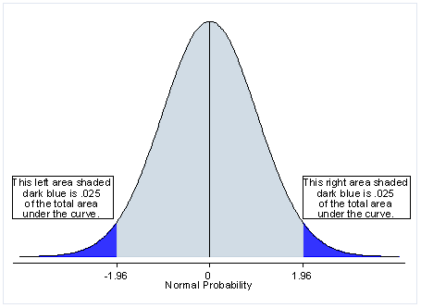
2-tailed Test
The critical value is the number that separates the “blue zone” from the middle (± 1.96 this example)
In a t-test, in order to be statistically significant the t score needs to be in the “blue zone”
If α = .05, then 2.5% of the area is in each tail

Slide 17
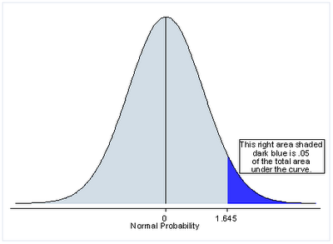
1-tailed Test
The critical value is either + or -, but not both.
In this case, you would have statistical significance (p < .05) if t ≥ 1.645.

Slide 18
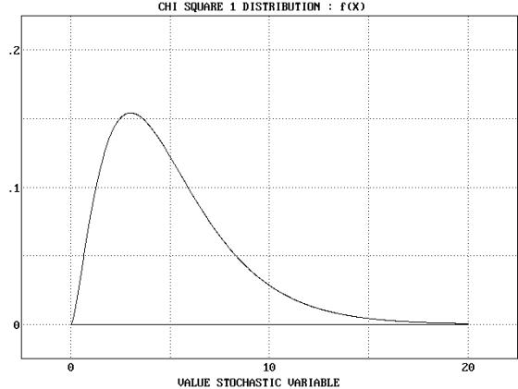
Chi-Square (χ²)
Any number squared is a positive number
Therefore, area under the curve starts at 0 and goes to infinity
To be statistically significant, needs to be in the upper 5% (α = .05)
Compares observed frequency to what we expected

Slide 19
So, what’s your data?
And what are you going to do about it?

Slide 20


